Slide 1
Warm Up
What is an ordered pair?
What are some types of representations of relations and situations?

Slide 2
Pass Back Test and Performance Task

Slide 3
Ways to represent Relations Foldable

Slide 4
Model for the vocabulary word: Function

Slide 5
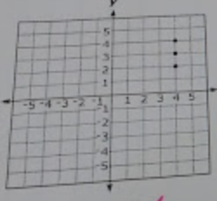
Is this a function?
Is this a function or not?
Why?

Slide 6
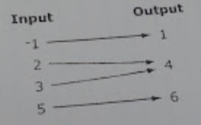
Is this a function?
Is this a function or not?
Why?

Slide 7
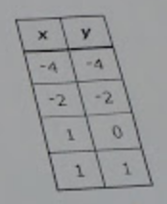
Is this a function?
Is this a function or not?
Why?

Slide 8
Homework 3.1 Ready and Set

