Slide 1
Unit 2 Exponential Functions

Slide 2
Warm Up
Identify if the scenarios described below are linear, exponential, or neither. Justify your answer.
From 1910 until 2010 the growth rate of the United States has been steady at about 1.5% per year. The population in 1910 was about 92,000,000.
The circumference of a circle as a function of the radius.
According to an old legend, an Indian King played a game of chess with a traveling sage on a beautiful, hand-made chessboard. The sage requested, as reward for winning the game, one grain of rice for the first square, two grains for the second, four grains for the third, and so on for the whole chess board. How many grains of rice would the sage win for the nth square?
The volume of a cube as a function of its side length.
Exponential
Linear
Exponential
Neither

Slide 3
https://www.youtube.com/watch?v=5iTTNRE-njM

Slide 4
How Many Views does it take to go viral?
5 million views in
3-7 days

Slide 5
Viral Video Problem
Let’s say you share the video with 4 of your friends.
Within 10 minutes, each of those friends shares it with 4 different people.
After another 10 minutes, each of those people shares it with 4 more people, and so on.
Assume the video continues to be shared in this pattern.

Slide 6
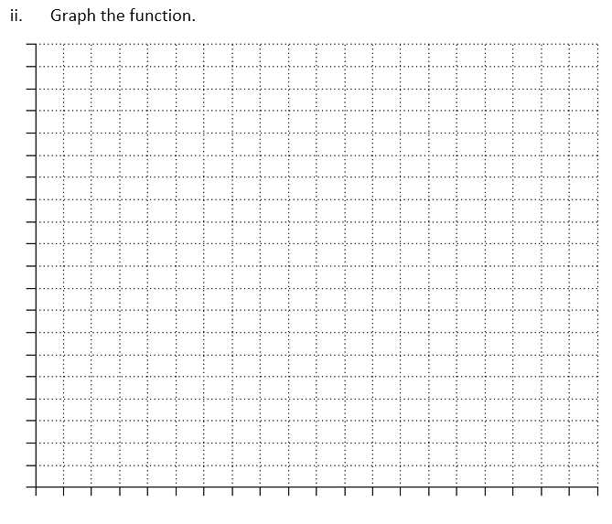
N(t) =

Slide 7
Does the Video go viral?
After How many minutes?

Slide 8
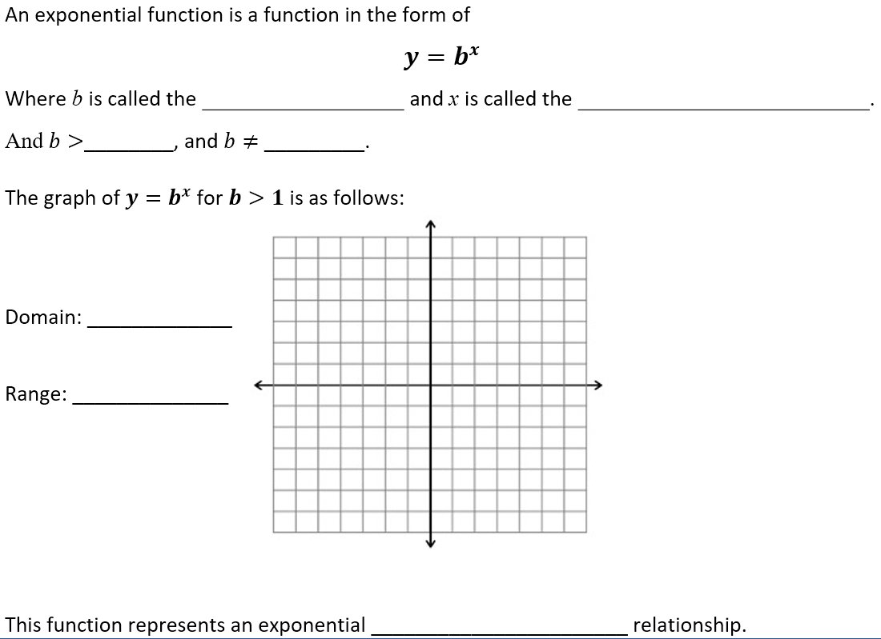
Exponential Functions
base
exponent
0
1
(- , )
8
8
b is called the GROWTH FACTOR
( , )
0
8
x
Ex: y = 3
growth

Slide 9
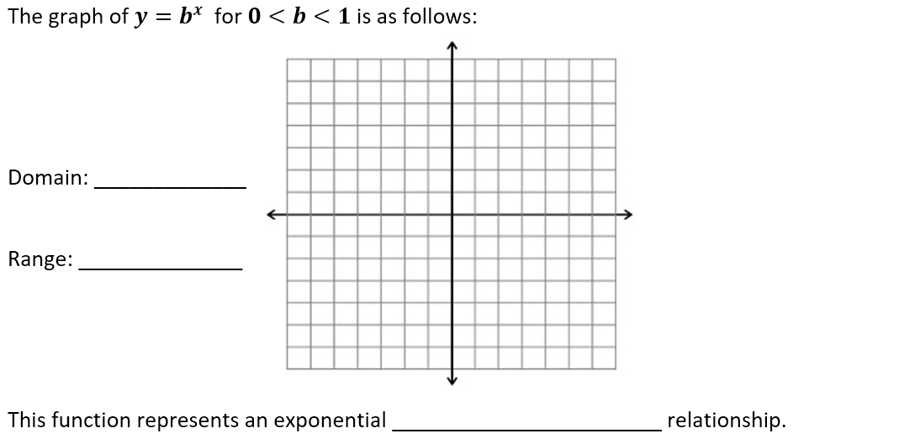
Exponential Functions
(- , )
8
8
b is called the DECAY FACTOR
( , )
0
8
x
Ex: y = (⅓)
decay

Slide 10
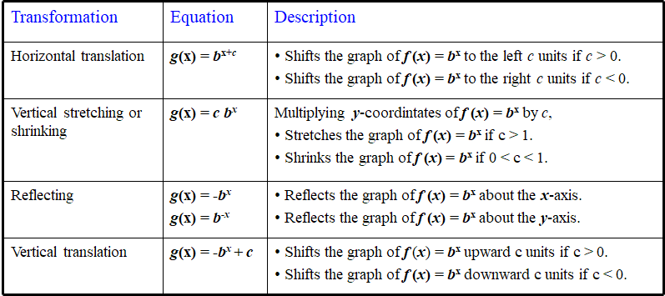
Transformations

Slide 11
Uranium 238 Problem
Uranium 238 is a radioactive material used in nuclear weapons, and to produce nuclear energy.
It decays exponentially with a half-life of about 4.5 billion years.

Slide 12
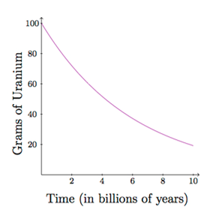
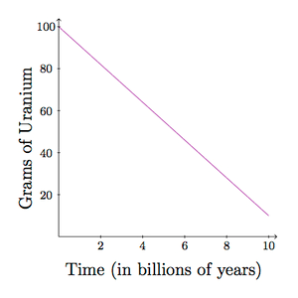
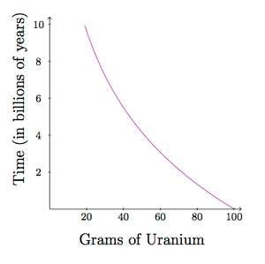
t/4.5
U(t) = 100 (½)
i.
ii.
iii.

