Slide 1
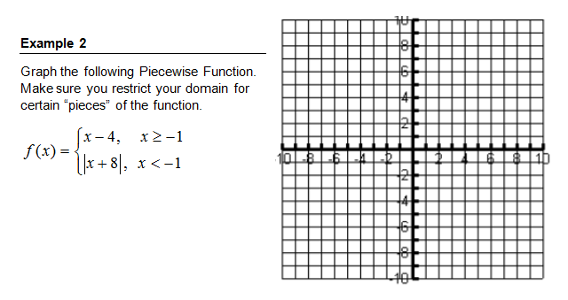
Warm Up

Slide 2
Homework Questions?

Slide 5
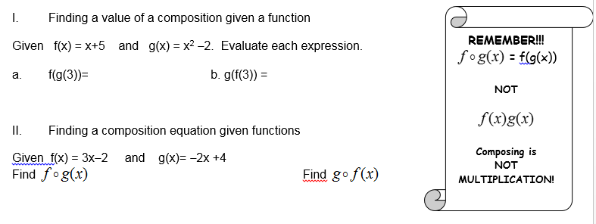

Slide 6
Add Um Up Activity

Slide 7
Solving Systems of Inequalities

Slide 8
Solving Absolute Value Inequalities

Slide 9
Homework
Page 15 #7-10
Page 16 #11-20

