Slide 1
Exponential Functions & Introduction to Logarithmic Functions

Slide 2
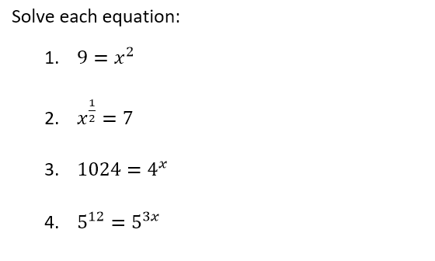
Warm Up

Slide 3
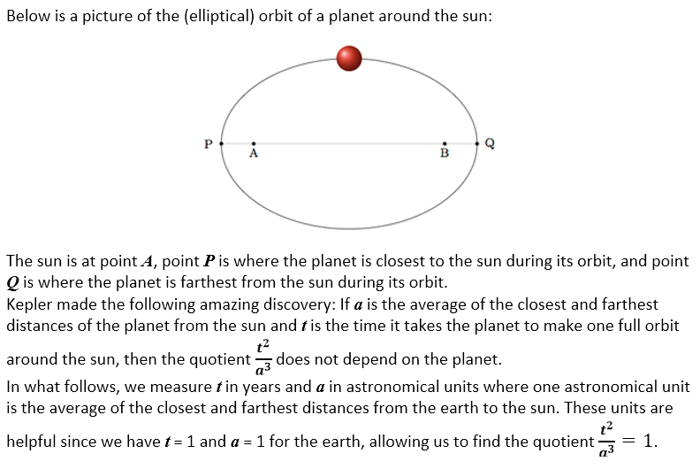
Kepler’s 3rd Law

Slide 4
Let’s Discuss
How do you solve the following equation:

Slide 5
Recall: Viral video problem

Slide 6
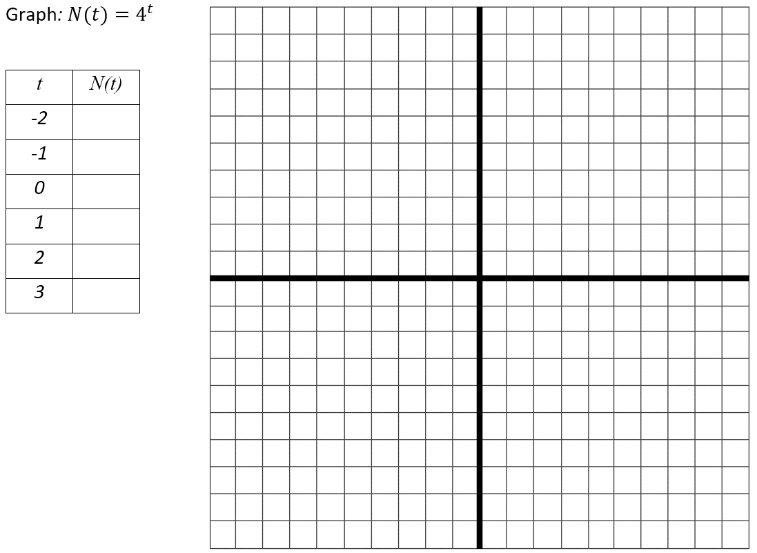
Find the Inverse

Slide 7
Log of y, Base b
x
y=1 is not an exponential function.
x
b cannot be 0.

Slide 9
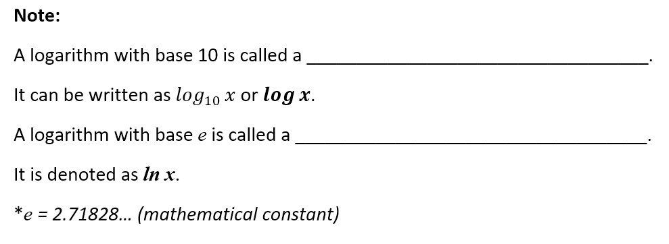
common logarithm
natural logarithm

