Slide 1
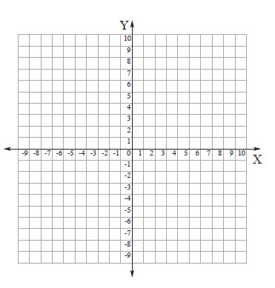
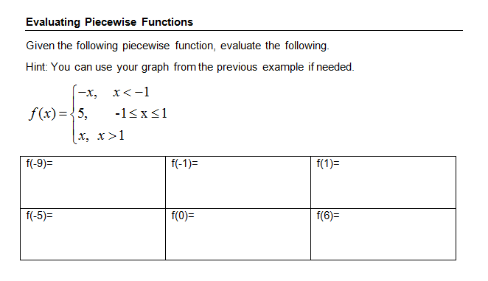

Warm Up
Use the information you know for solving absolute value inequalities to solve absolute value equations.
$$\left|−2x+7\right|=25$$
Graph: $f\left(x\right)<\left|x−2\right|+1$

Slide 2
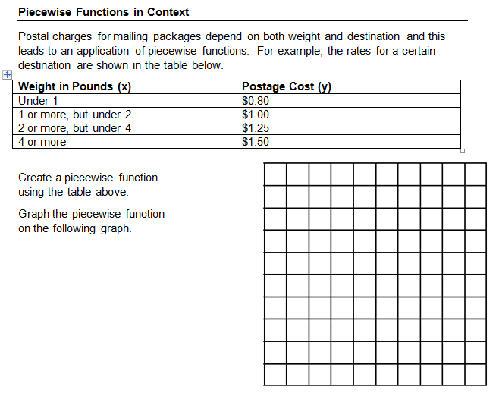
Piecewise Word Problems

Slide 3
Objective: SWBAT Evaluate Inverse Functions

Slide 5
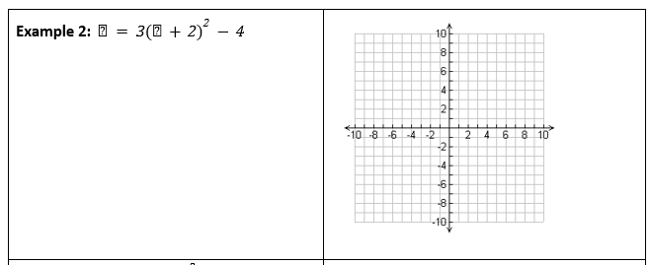
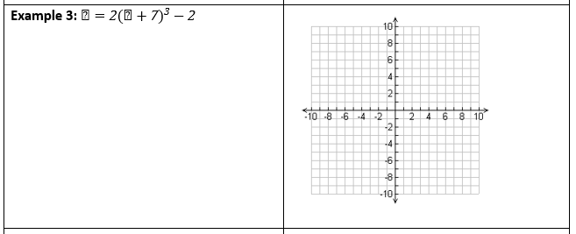

Slide 6
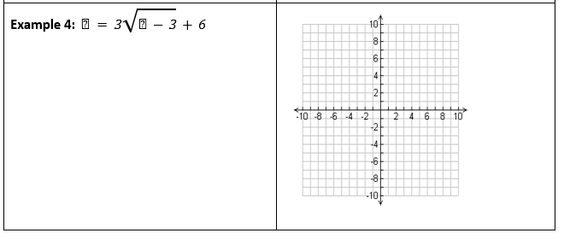

Slide 7
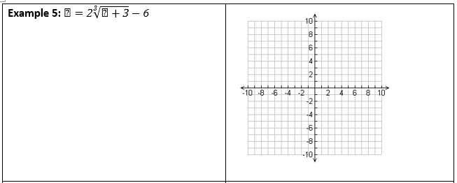

Slide 8
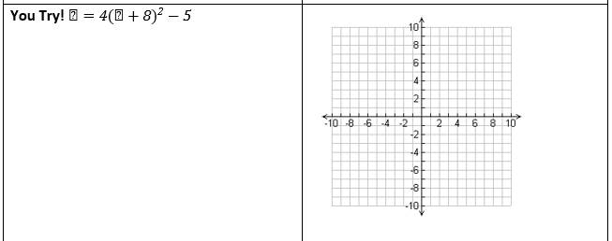
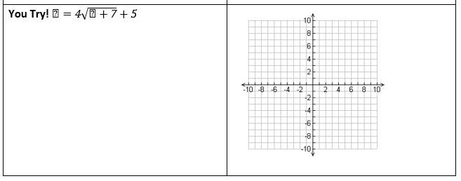

Slide 10
Homework
pg. 26 #8 - 14
Study you have a Quiz Friday and a Test Tuesday

