Slide 1
Logarithmic Rules

Slide 2
Rules of logarithms
* * * You will need this one to calculate log
on your calculator! * * *

Slide 3
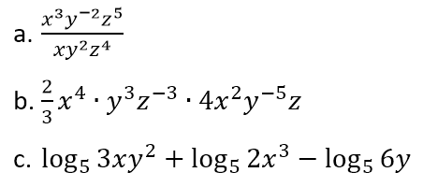
Exit ticket
How are exponential and logarithmic functions related?
If , then w =
If log 250 = r , then 250 =
Simplify the following:
Elliot decided to open a savings account. He deposited $100 into the account, which pays 5% interest compounded monthly. What will his account balance be after 6 years if he does not make any additional deposits?

