Slide 1
Warm up
Notes:
Yes; common difference = -0.2
No; common ratio = -1
No; common ratio = 2
No; no common difference

Slide 2
Arithmetic Sequences
Arithmetic Sequences go from one term to the next by adding the same value
2, 5, 8, 11, 14…
7, 3, -1, -5…
The number added each time is called the Common difference (d)
Common Difference (d)
=_________
Common Difference (d)
=_________

Slide 3
Arithmetic Sequences
To find the common difference, pick one term and subtract the term before it
3, 11, 19, 27, 35
Common Difference (d)
=_________

Slide 4
Geometric Sequences
Geometric Sequences go from one term to the next by multiplying by the same value
1, 5, 25, 125, 625…
48, 24, 12, 6…
The number multiplied each time is called the Common ratio (r)
Common Ratio (r)
=_________
Common Ratio (r)
=_________

Slide 5
Geometric Sequences
To find the common ratio, pick one term and divide it by the term before it
1, 4, 16, 64, 256
Common Ratio (r)
=_________

Slide 6
Remember:
If you add the same value to get from one term to the next, you have an arithmetic sequence.
Arithmetic sequences have a common Difference (d)
If you multiply by the same value to get from one term to the next, you have a geometric sequence
Geometric sequences have a common Ratio (r)
Sequences without a common ratio or a common difference are neither geometric or arithmetic

Slide 7
1) Determine if the sequence is Arithmetic, geometric, or neither. Then identify the common ratio or difference, if one exists.
Arithmetic
Geometric
Neither
2, 6, 18, 54, 162…
Difference (d)
Common =
Ratio (r)

Slide 8
2) Determine if the sequence is Arithmetic, geometric, or neither. Then identify the common ratio or difference, if one exists.
Arithmetic
Geometric
Neither
14, 34, 54, 74, 94…
Difference (d)
Common =
Ratio (r)

Slide 9
3) Determine if the sequence is Arithmetic, geometric, or neither. Then identify the common ratio or difference, if one exists.
Arithmetic
Geometric
Neither
4, 16, 36, 64, 100…
Difference (d)
Common =
Ratio (r)

Slide 10
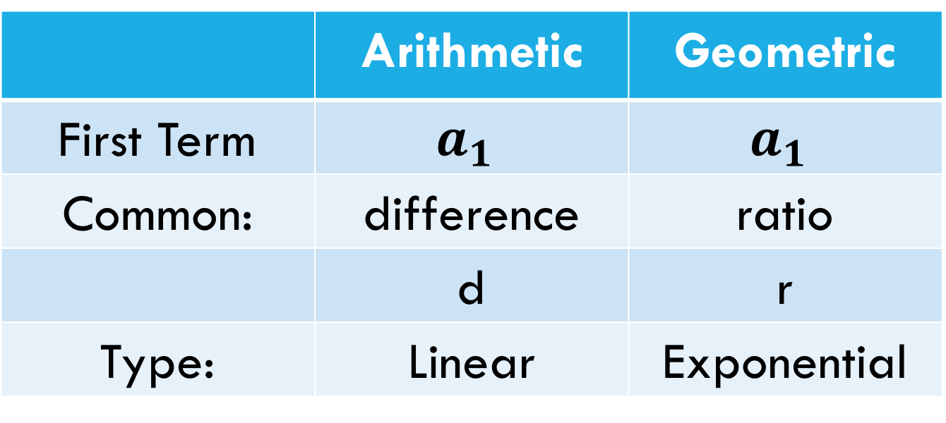
Writing a sequence
The first term of a sequence is called the initial term
We label this term $a_{1}$
 | Arithmetic | Geometric
First Term | $$a_{1}$$ | $$a_{1}$$
Common: | difference | ratio
 | d | r
Type: | Linear | Exponential

