Slide 1
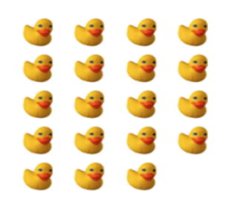
Without counting one-by-one, how many ducks are there?
How do you know? Explain.

Slide 2
Homework Questions

Slide 3
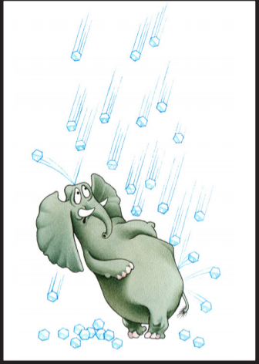
Oh Hail the elephant!
Hailstone sequences are numbers that go up and down again.
For example:
20 - 10 - 5 - 16 - 8 - 4 - 2 - 1
Hailstone sequences follow these rules:
If a number is even, divide it by 2
If a number is odd, multiply it by 3 and add 1

Slide 4
conjectures – it is an idea that you think might be true but you do not know
for sure.

Slide 5
Your Turn!
Get in groups of 3
I will come and give you a number and you will do the hailstone sequence rules on these numbers.
Record what you do.

Slide 6
Stacking cup Activity
Find a different group.
Get to a pyramid without touching any of the cups and only using the rubber band and string.

Slide 7
Order of Operations
Review

Slide 8
Four 4’s Activity
Find every number 1 to 20 using only four 4’s (all must be used all the time)
You can use exponents, division, multiplication, fraction, subtraction, addition

Slide 9
Leading with lollipops

