Slide 1
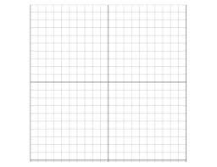
Warm Up
Write equation in point-slope form: $y−y_{1}=m(x−x_{1})$
Slope: -2
Point: (-3, 6)
Graph the line if the line crosses through points (4, 8) and (-2, -3)

Slide 2
Check Homework and go over homework

Slide 3
Separate Sheet Work

