Slide 1
Welcome to Foundations of Math 1!!

Slide 2
Hello!
Notes:
Graduate of NC State
Head Volleyball Coach
Student Taught here with Ms. Brooks and Mrs. Schlimme
Love Math
I have a dog named boomer 78lbs

Slide 3
Syllabus
Canvas
Attendance
Interactive Notebooks
Everyday
Warm up
Homework Sheet
Sticker Sheet

Slide 4
Communication!
Remind
Text @edhh4f to 81010
Email
sgblue@wcpss.net

Slide 5
What Are your Classroom Expectations?
Notes:
Give examples
Share with partners
Classroom discussion and make poster

Slide 6
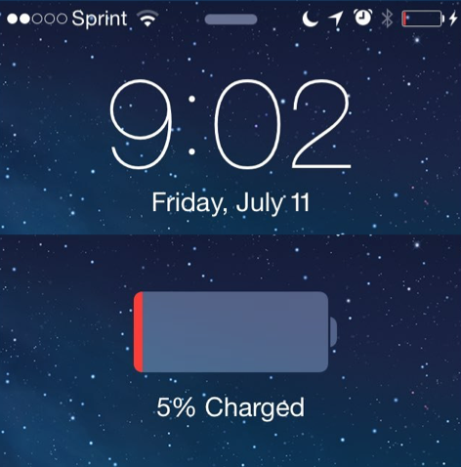
Iphone Activity
What do you notice?
What do you wonder?

Slide 7
When will the phone be fully charged?

Slide 8
On your paper, write 3 guesses for the time when the phone will be 100% charged:
Too Low
Too High
Just Right

Slide 9
Is there any information that would help you to make a better guess?

Slide 10
Work with a person near you to decide what time the phone will be 100% charged.

Slide 11
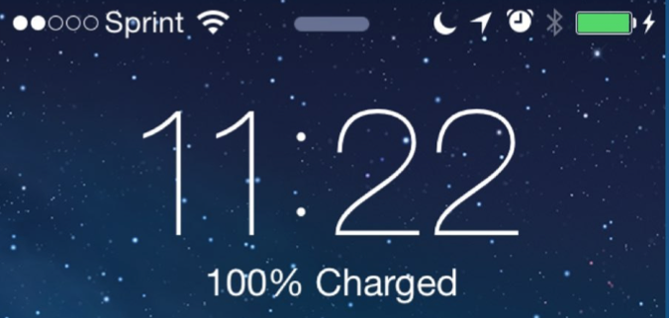
Look what really happened:

Slide 12
Takeaways:
All ideas are valued in this class.
Everyone can make observations (notice).
Everyone can ask questions (wonder).
You will work both independently and in groups.
Math allows us to create models

Slide 13
Flags
Name:
Goal this year:
Goal this semester:
I’m nervous about…:
How Ms. Blue Can Help Reach your goals:

Slide 14
Kid president Pep Talk

Slide 15
Homework Worksheet
Info Sheet
Parent Contact Sheet

Slide 16
THANKS!
Any questions?

