Slide 1
Number Talk
Without completing any calculations, determine if there are more inches in a mile or seconds in a day.
Notes:
Students will have 3 minutes to think independently before discussing as a class

Slide 2
Human Bingo!
Draw a rectangle on a scrap piece of paper
that is five by five.

Slide 3
Human Bingo
In the middle box put a free box!
Fill the rest of the boxes with these:
Has a relative in another state
Does not like ice cream
Favorite color is green
Favorite food is pizza
Favorite subject is math
Has an older brother
Learned something new over break
Was born in the same month as you
Plays a musical instrument
Read 2 books over summer break
Knows karate
Likes to play chess
Can do a backflip
Plays soccer
Likes to draw
Saw fireworks on New Year’s Eve
Went to the library in the past month
Likes broccoli
Has your eye color
Has a younger sister
Has been to the beach
Has a dog
Favorite subject is reading
Had a birthday in December

Slide 4
Translating math words
Think about words that tell us to add, subtract, multiply and divide.
Notes:
Addition:
add
altogether
both
combined
how many
increase
join
plus
sum
together
total
Subtraction:
deduct
detract
decrease by
difference
how many more?
how many left?
left over
less than
minus
reduce
remains
remove
subtract
take away
Multiplication:
as much
by
equal groups
groups of
lots of
multiply
multiplied by
per
product of
times
Division:
average
divide
each
equal parts
evenly
every
out of
quotient
ratio
shared equally
split

Slide 5
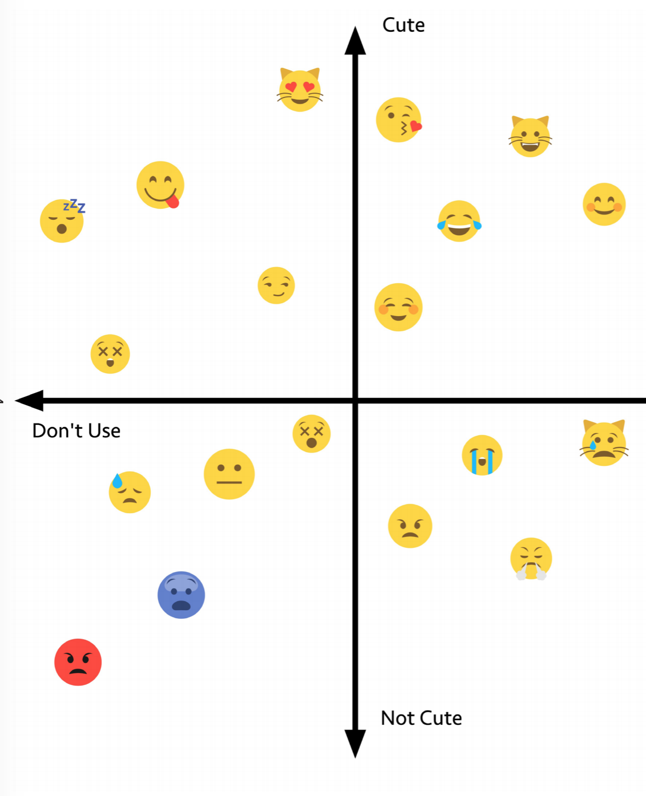
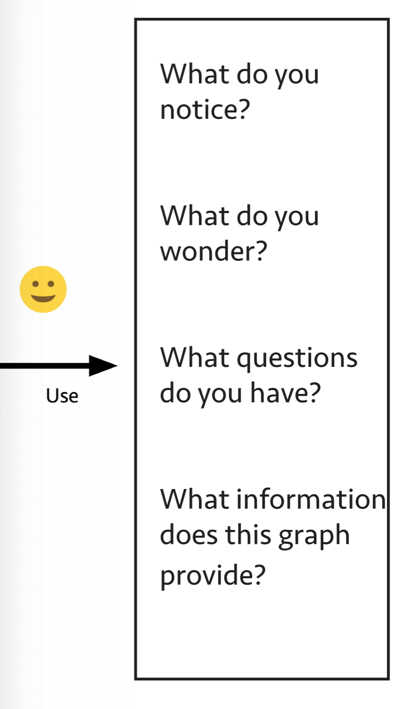
Answer these questions individually

Slide 6
Work in groups to create your own graph.
Choose the topic of the graph and the two dimensions it varies along.

Slide 7
Famous Failures before successes

