Slide 1
Introduction to Math 3
Objective: To review functions and function notations
Main Topics in Unit 1: Functions and their Inverses

Slide 2
Is it a Function?
Determine if the relationships stated below represent a function.
(x, y) = (boys name, color of hair)
(x, y) = (color of hair, boys name)
(x, y) = (price of calculator, amount of sales tax)
(x, y) = (zip code of student, student height)
(x, y) = (miles driven since you last filled up, amount of gas in gas tank)

Slide 3
With your group, create 3 additional relationships. Follow the criteria below when creating the relationship.
Not A Function
Is A Function
Is still a function if you exchange the x and y variables.

Slide 4
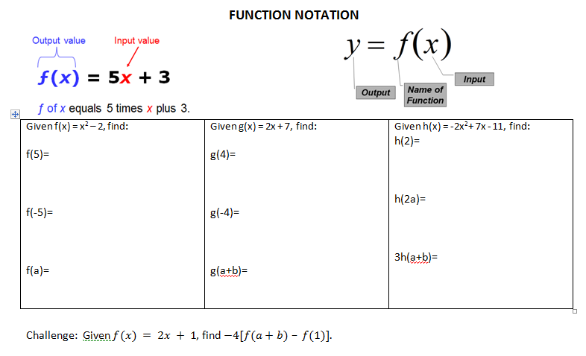

Slide 5
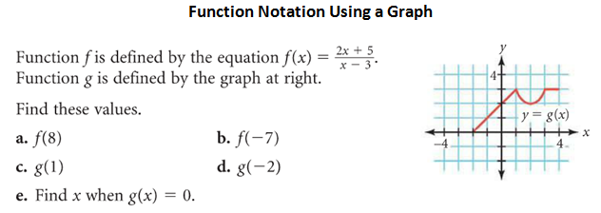

Slide 6
Just to Summarize?
What makes a function?
A relation from a set X to a set Y is called a function if each element of X is related to exactly one element in Y. ... Relation from X to Y that is a function: { (1,d) , (2,d) , (3, a) } This is a function since each element from X is related to only one element in Y.
Notes:
Vertical Line Test

Slide 7
Unit 1 Domain, Range
Objective: To evaluate systems of equations including Domain and Range

Slide 8
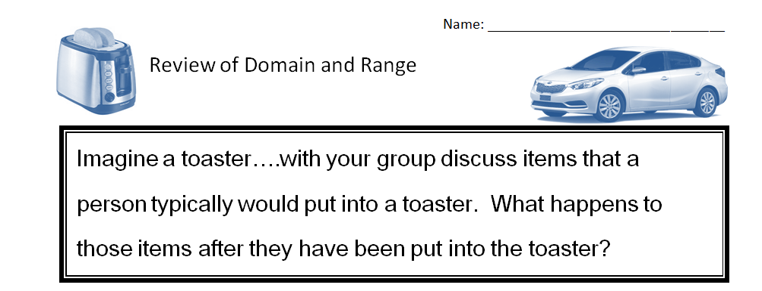

Slide 9
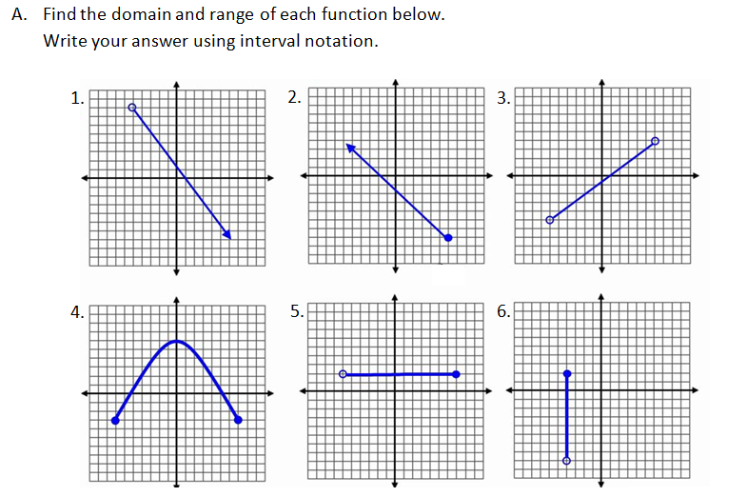

Slide 11
Unit 1 Piecewise Functions
Objective: SWBAT evaluate piecewise functions

Slide 13
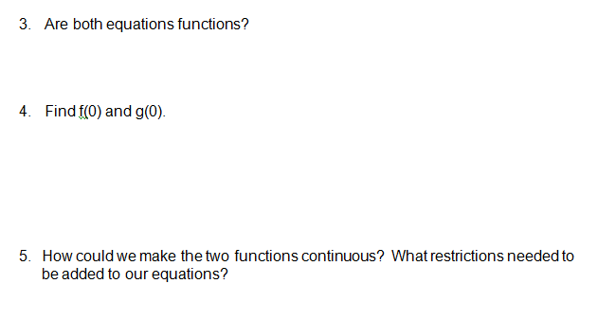

Slide 14
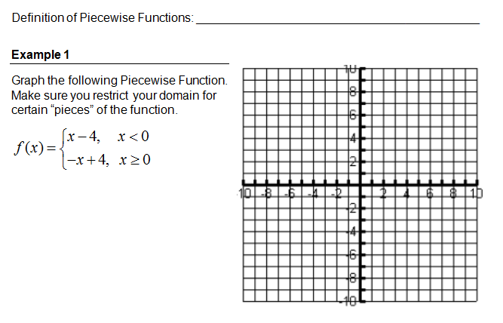

Slide 15
