Slide 1
Go over quiz

Slide 2
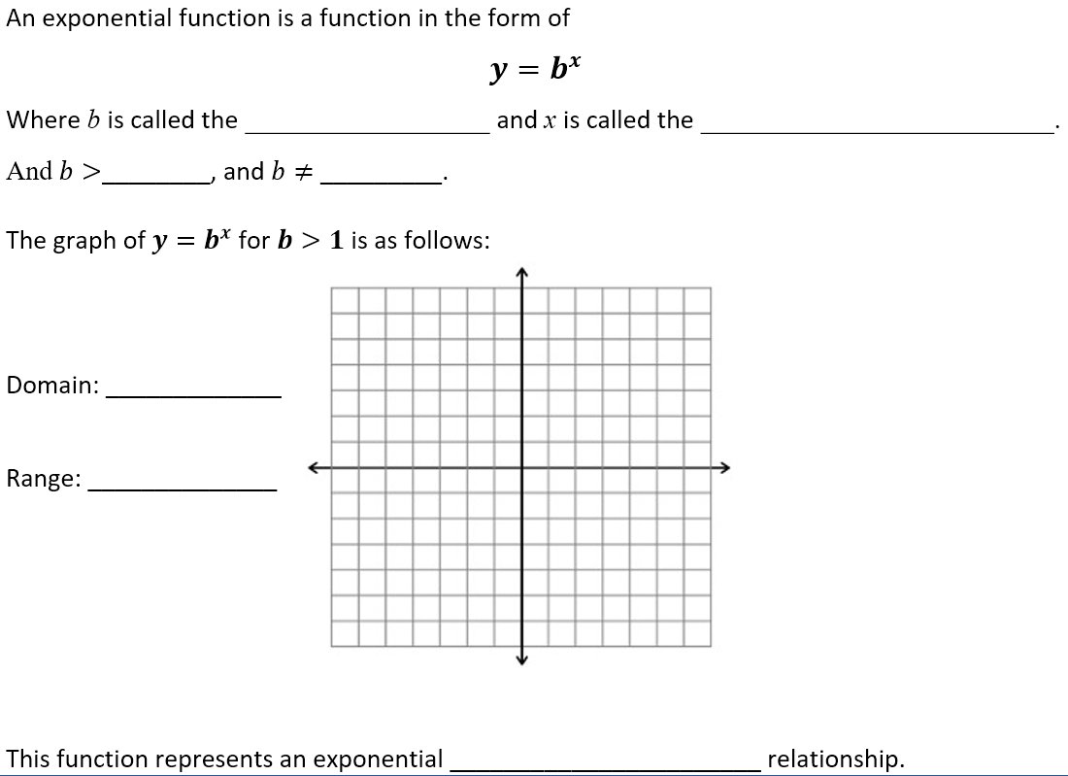
Exponential Functions
base
exponent
0
1
(- , )
8
8
b is called the GROWTH FACTOR
( , )
0
8
x
Ex: y = 3
growth

Slide 3
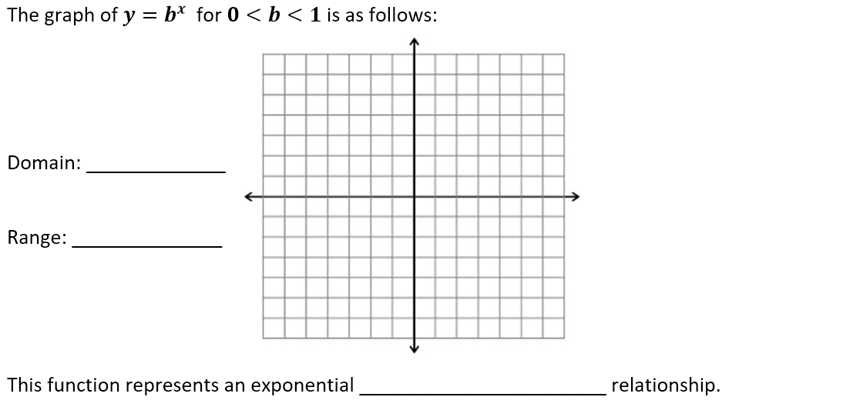
Exponential Functions
(- , )
8
8
b is called the DECAY FACTOR
( , )
0
8
x
Ex: y = (⅓)
decay

Slide 4
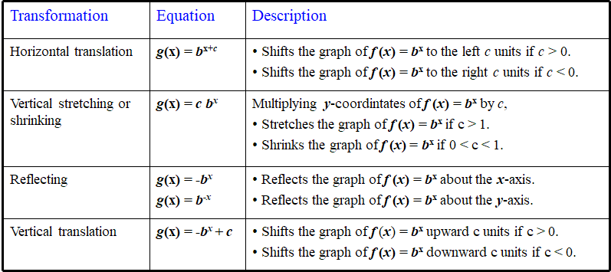
Exponential Functions

Slide 5
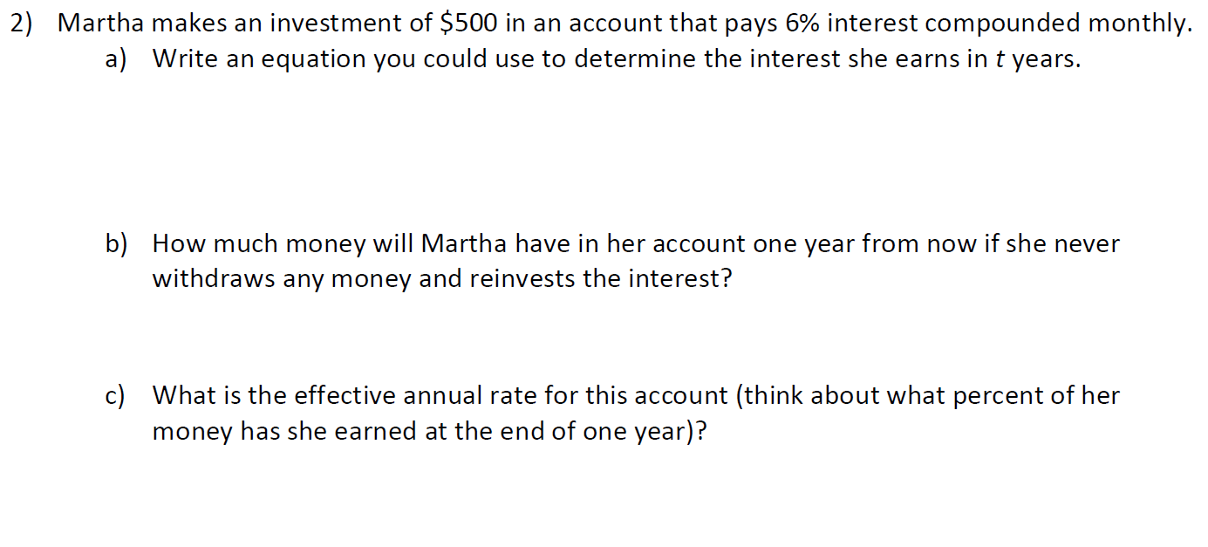
Compound Interest Review

Slide 6
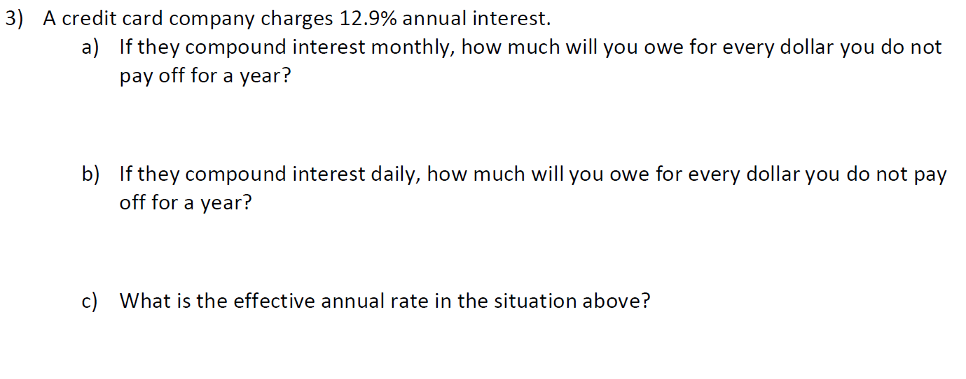

Slide 7
Half Life
The half life of caffeine is 5 hours. A grande Peppermint Mocha has 330 milligrams of caffeine. Let Q(t) denote the amount of caffeine in your system t hours after consuming your grande Peppermint Mocha. For simplicity, assume the entire grande Peppermint Mocha is consumed instantly.
How many milligrams of caffeine will be in your system after 5 hours? After 10 hours? After 15 hours?
Qt=Q012t/k. Find Q0 and k.
How many milligrams of caffeine will be in your system after 2 hours?

Slide 8
Exponential Problem
The world population in 2000 was approximately 6.08 billion. The annual rate of increase was about 1.26%
Find the growth factor for the world population
Suppose the rate of increase continues to be 1.26%. Write a function to model the world population.
Let x be the number of years past the year 2000. Find the world population in 2010.

Slide 9
Task 2.6b

Slide 10
Homework: 2.6b Set and Go

