Slide 1
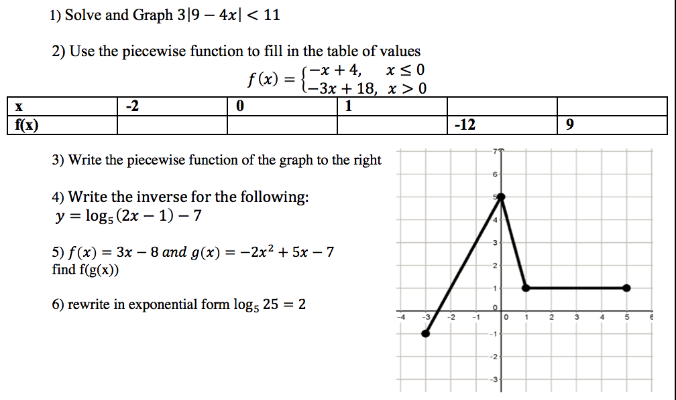
Warm Up

Slide 2
Unit 4 Test

Slide 3
Unit 1/Unit 2
Piecewise functions
Absolute Values
Solving and graphing
Inverses of functions
Varies Directly and Inversely
Compositions

Slide 4
Solving Absolute Values
Solving absolute value equations
Example: -5|3x+4| = 7
Solving and graphing absolute value inequalities
More is “or”
Less is “nest”

Slide 5
Solving and Graphing Absolute Value Inequalities
Example: 3|9 - 4x| < 11
Example: |2x + 5| > 6

Slide 6
Inverses of functions
How do I find an inverse?
Switch the x and y value in the equation
Solve for y
Make the range become the new domain of the new equations, and make the domain become the new range of the new equation

Slide 7
Varies Directly/Inversely/Jointly
Direct Variation
y = kx
Inverse Variation
y = k/x or xy = k
Joint Variation is like direct variation but involves more than one variable
y = kxz

Slide 8
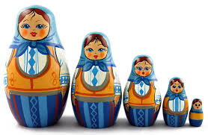
Compositions
f(g(x))
f(g(2))

Slide 9
Unit 3
Logarithms
Graphing
Converting to Exponential
Solving
Evaluating
Exponential Functions
Convert to Logarithms
Applications
Compound interest
Half Life

Slide 10
Logarithms to Exponential Equations

Slide 11
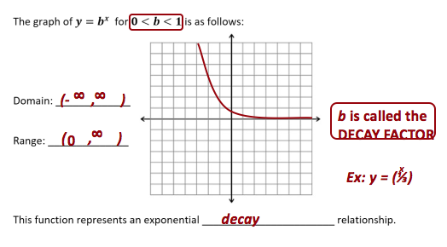
Exponential Function

Slide 12
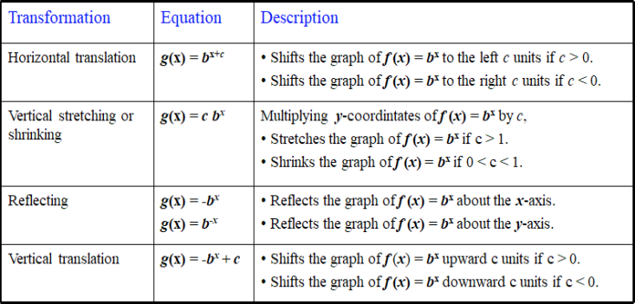
Exponential Function Transformations

Slide 13
Compound Interest

Slide 14
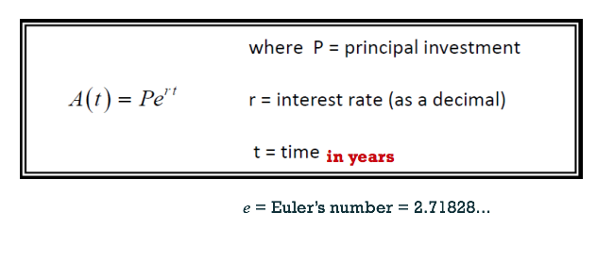
Continuously Compounded

Slide 15
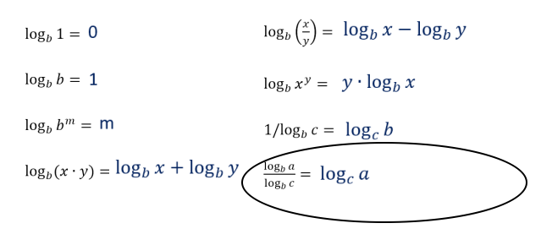
Logarithmic Rules

Slide 16
Important Exponential Equation

