Slide 1
Check and go over homework

Slide 2
Question 1
The bear population increase at a rate of 2% per year. There are 1573 bears this year. Write a function that models the bear population. How many bears will there be in 10 years?

Slide 3
Question 2
Convert to exponential form
$$\log_{x}{11}=y$$

Slide 4
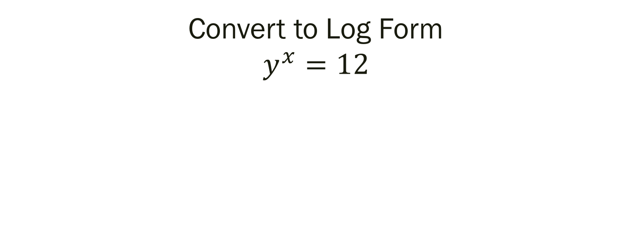
Question 3
Convert to Log Form
$$y^{x}=12$$

Slide 5
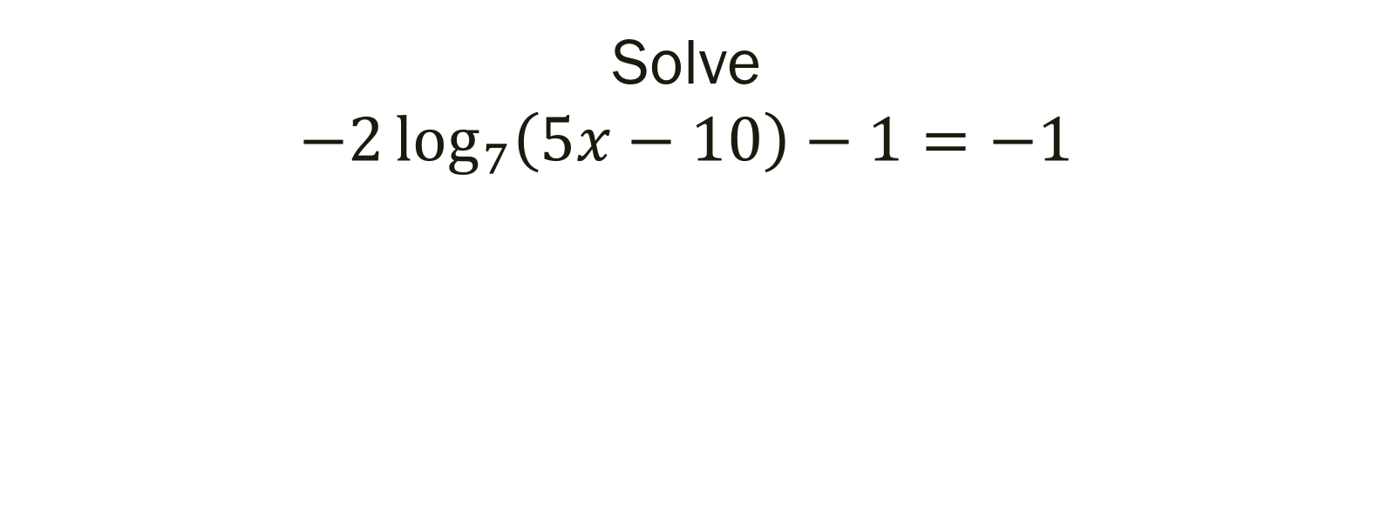
Question 4
Solve
$$−2\log_{7}\left(5x−10\right)−1=−1$$

Slide 6
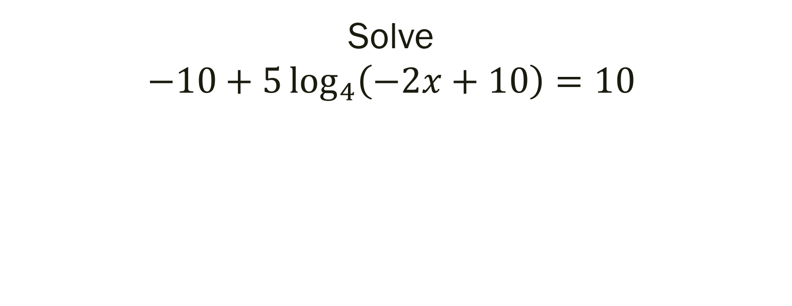
Question 5
Solve
$$−10+5\log_{4}\left(−2x+10\right)=10$$

Slide 7
Question 6
How much money will you have in 8 years if you invest $4000 at 3.5% compounded quarterly?

Slide 8
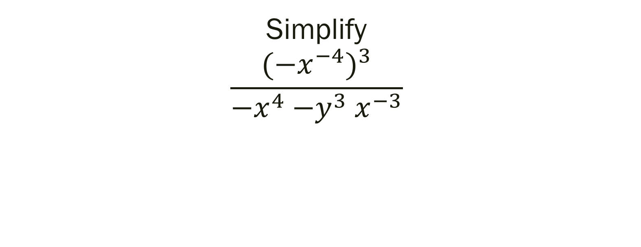
Question 7
Simplify
$$\frac{{{(−x}^{−4})}^{3}}{{−x}^{4}{−y}^{3}x^{−3}}$$

Slide 9
Question 8
The half-life of isotope x is 2 years. How many years would it take for a 4.0mg sample of X to decay and have only 0.50mg of it remain?

Slide 10
Question 9
A cable company with a reputation for poor customer service is losing subscribers at a rate of approximately 3% per year. The company had 2 million subscribers at the start of 2014. Write the equation.

Slide 11
Question 10
Convert
$$\log_{8}{2}=\frac{1}{3}$$

Slide 12
Question 11
Convert
$$e^{x−1}=45$$

Slide 13
Question 12
How much money will you have in 6 months if you invest $1000 at 3% compounded monthly?

Slide 14
Question 13
Simplify
$${(\frac{3x^{2}}{3x^{2}})}^{3}$$

Slide 15
Question 14
Selenium-83 has a half-life of 25 minutes. How many minutes would it take for a 10.0mg sample to decay and have only 1.25mg of it remain?

