Slide 1
Attack Review Game
Seperate into groups of 4 groups of 5 and 2 groups of 6
I will ask the class a review question, all groups should discuss the questions and come up with an answer in case they get called on.
Then I will pick a group at random to answer the question
If the group gets the answer correct they get to attack any two castles (by drawing “Xs”)
If the group gives the wrong answer, I will attack their castle (by drawing an X)
Once a castle has been attacked 3 times, it is destroyed
Even though you are out you can still get questions right and take out revenge

Slide 2
If a=b then b=a is an example of what property?
Notes:
Symmetric Property

Slide 3
Is m<ABE = m<DRG and m<DRG = m<STR then m<ABE = m<STR is an example of what property?
Notes:
Transitive Property

Slide 4
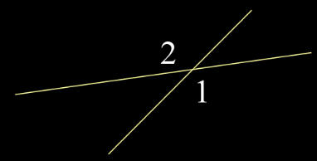
<1 and <2 are what kind of angles?
Notes:
Vertical Angles

Slide 5
m<1 + m<2 =?
Notes:
180

Slide 6
Notes:
X=23

Slide 7
If AB + BC = AC and BC = CE then AB + CE = AC is an example of what property?
Notes:
Substitution

Slide 8
If <1 and <2 are vertical angles and m<1 = x - 32 and m<2 = 175 - 2x, find m<2
Notes:
37

Slide 9
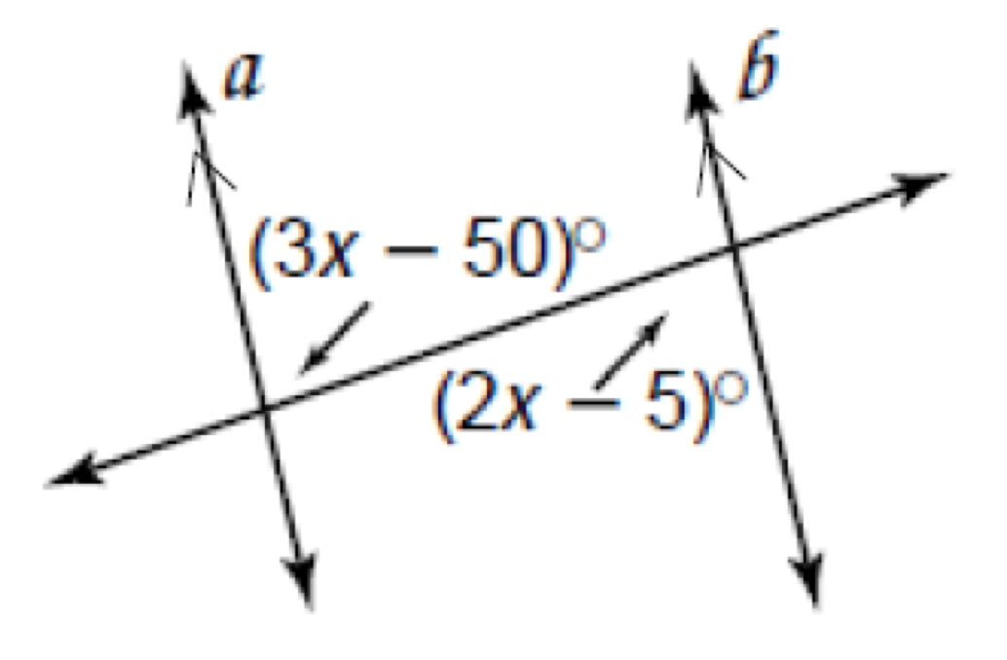
Find x
Notes:
X=45

Slide 10
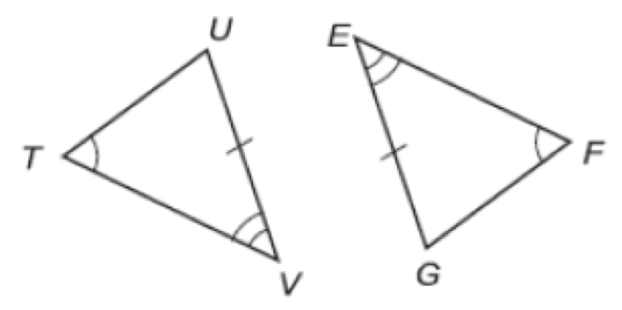
Determine whether each pair of triangles is congruent. If so, write a congruence statement and explain why the triangles are congruent. If it is not possible, write not possible
Notes:
AAS

Slide 11
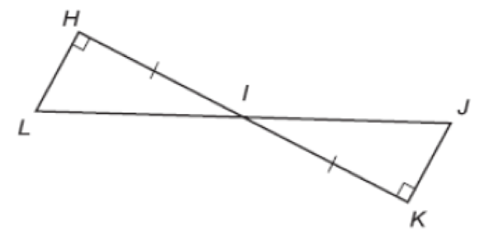
Determine whether each pair of triangles is congruent. If so, write a congruence statement and explain why the triangles are congruent. If it is not possible, write not possible
Notes:
ASA

Slide 12
In parallelogram RSTV, diagonals RT and VS intersect at Q. If RQ = 5x+1 and QT = 3x+15, find QT
Notes:
X=7

Slide 13
What is the equation of the circle with radius 6 and centered at (4, -8)
Notes:
(x-4)^2 + (x+8)^2 = 36

Slide 14
To draw a circle around a triangle so that all three vertices are on the circle, use incenter, circumcenter, orthocenter or centroid?
Notes:
circumcenter

Slide 15
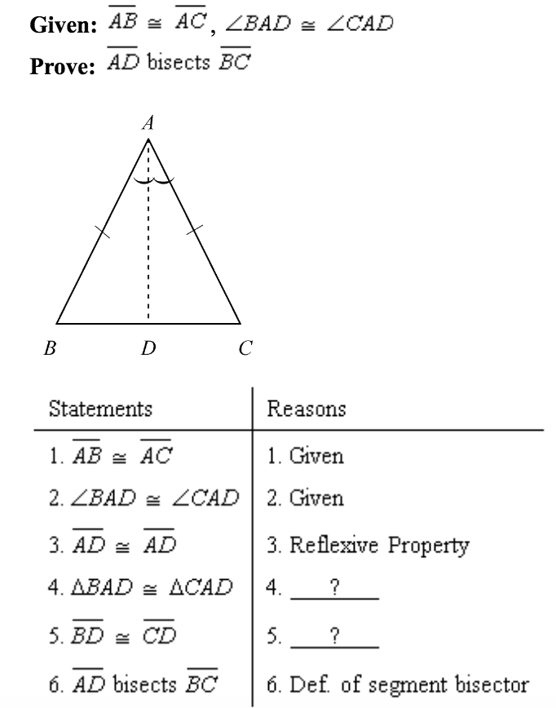
ASA; CPCTC
SAS; Reflexive Property
SSS; Reflexive Property
SAS; CPCTC
Notes:
D

Slide 16
Is a square always a rectangle? True or False
Notes:
True

Slide 17
Is a rectangle sometimes a square? True or False
Notes:
true

Slide 18
The “geographic center” or “balance point” of a triangle is incenter, circumcenter, orthocenter or median
Notes:
median

